Slide 1
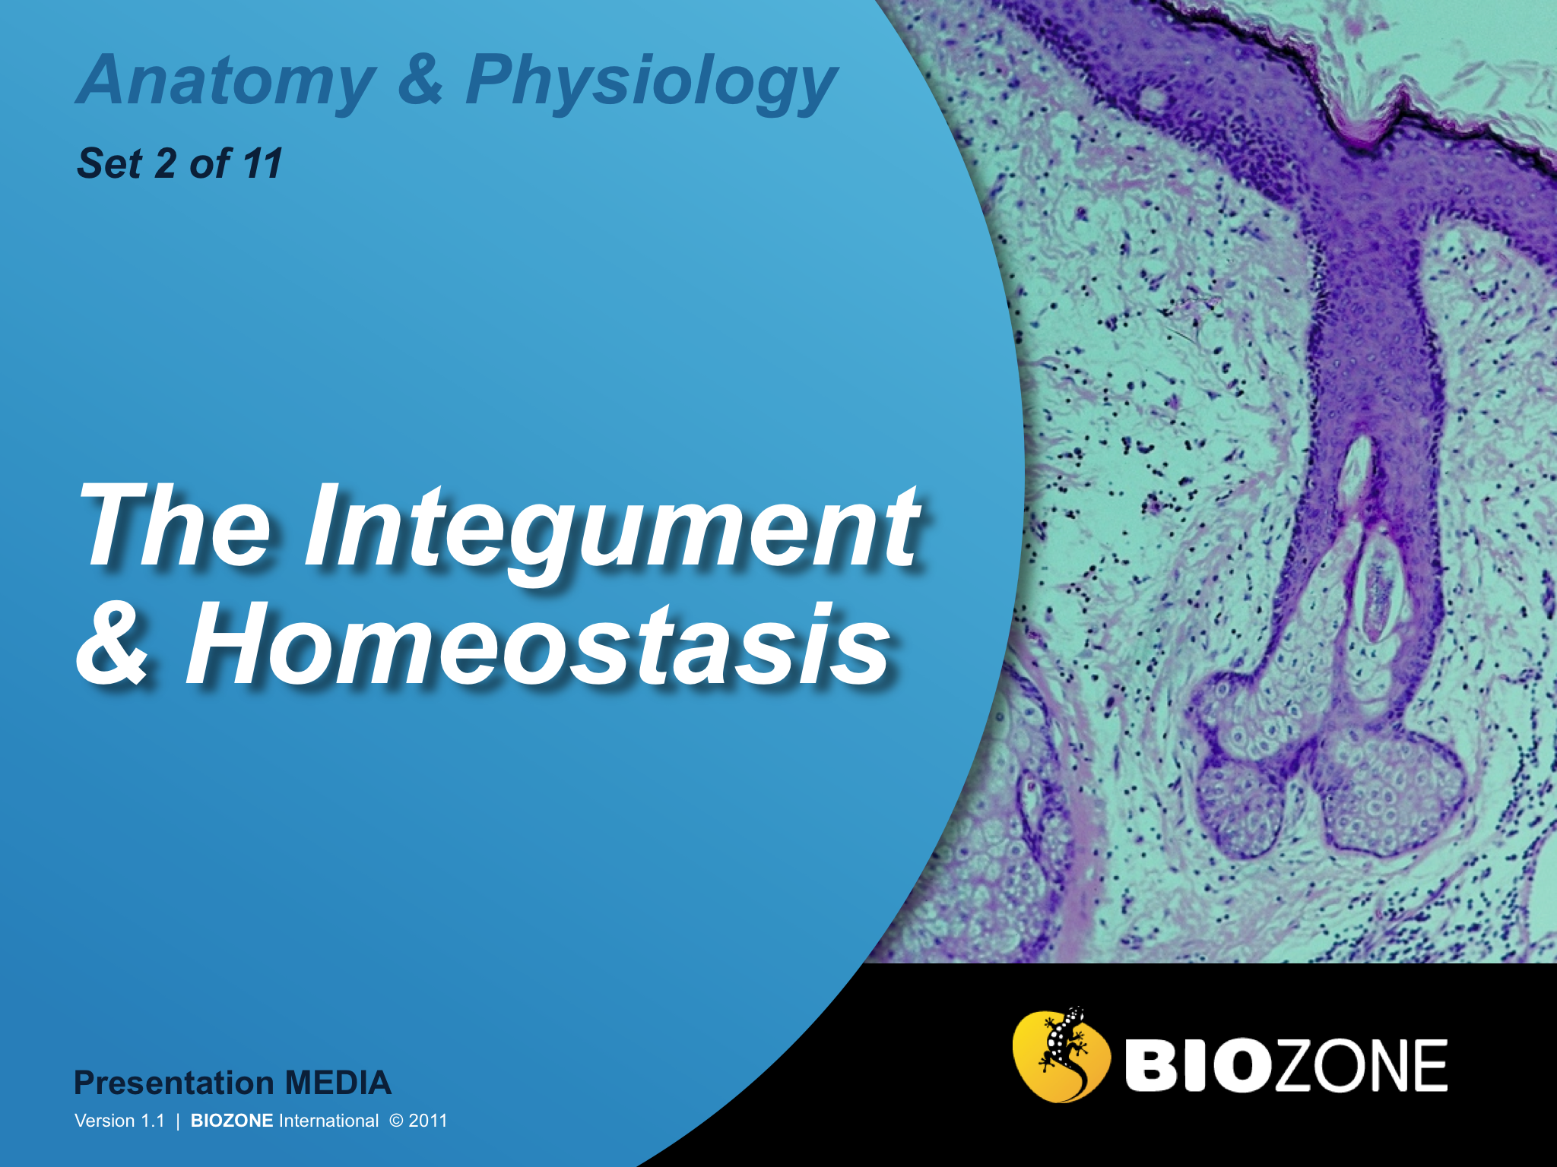

Slide 2
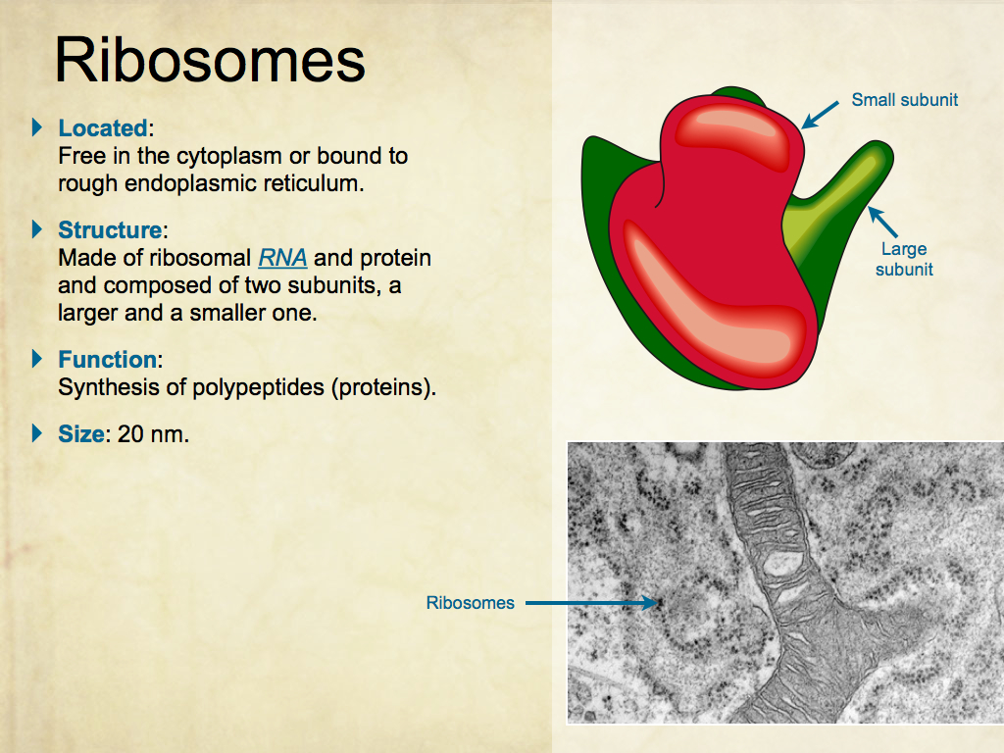
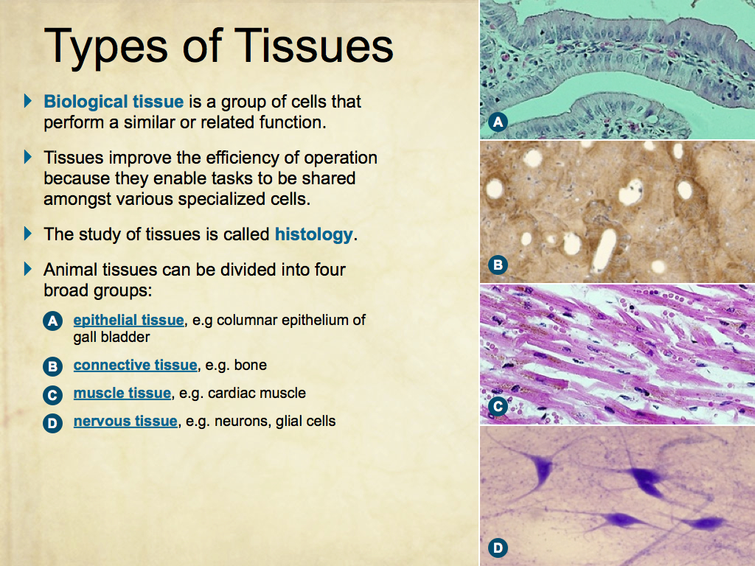
Using Presentation Media
BIOZONE Presentation Media
can be used either as a simple slide show or as an interactive lesson.
  Hyperlinks within the text take you to related slides.
Italicized hyperlinks link to the glossary of definitions.
Bold hyperlinks give direct access to specific slides.

Slide 3
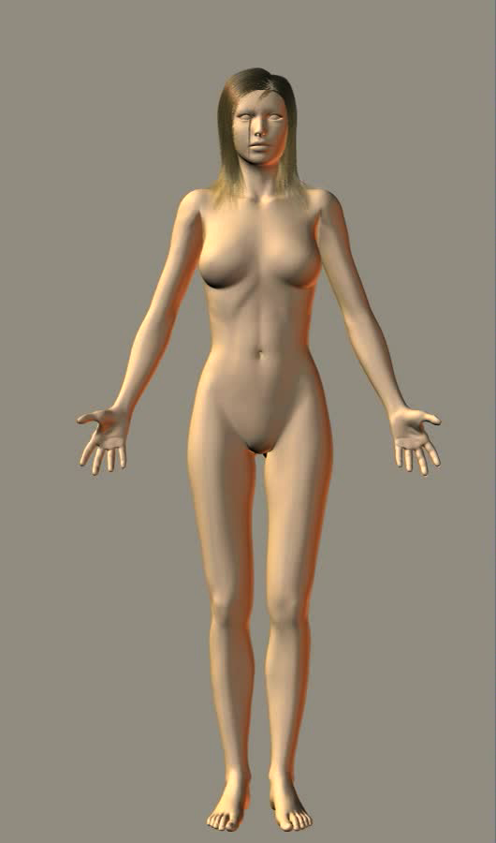
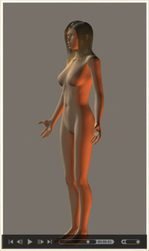
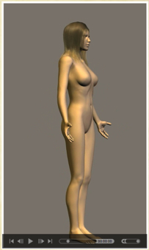
Using Presentation Media
BIOZONE Presentation Media can be used either as a simple slide show or as an interactive lesson
  The movie player allows you to rotate objects.
The movie loops continuously when activated
Use the movie controls in Keynote or Powerpoint
Pause the movie, then drag the slider to rotate the object back and forth

Slide 4

Locating Body Structures
  Directional terms
  Body planes
Homeostasis
  Homeostasis
  Feedback systems
Membranes and Cavities
  Body membranes
  Body cavities
Maintaining Homeostasis
  Maintaining homeostasis
The Integumentary System
  The integumentary system
  Structure of the skin
  Functions of the skin
  Thermoregulation
Diagnostic Imaging
  Diagnostic imaging
Glossary

Slide 5
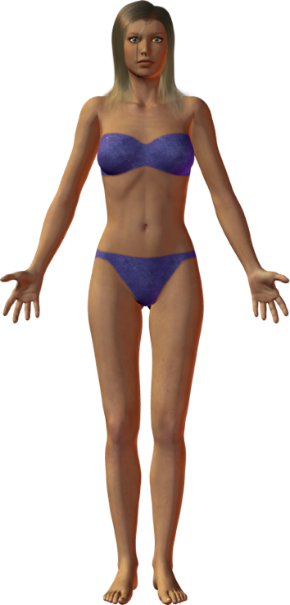

Locating Body Structures
The location and orientation of structures is important when studying human anatomy.
Descriptions and locations of body structures assume the body is in the anatomical position.
  Standing erect, facing the observer
  Feet flat on the floor
  Hands at sides, palms turned forward.
Directional terms describe the orientation and position of organs and structures from this position.
The anatomical position

Slide 6

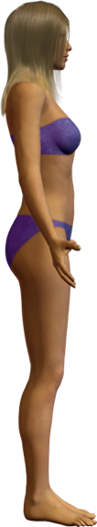
Directional Terms
Midline
Lateral
Medial
Superior
Specific terms are used to give the location and orientation of structures.
Many of these terms come
in pairs:
  proximal / distal
  superior / inferior
  lateral / medial
  anterior / posterior
It is easier to locate and describe structures and movements accurately if you understand these terms.
Proximal
Posterior
(dorsal)
Anterior
(ventral)
Distal
Inferior

Slide 7
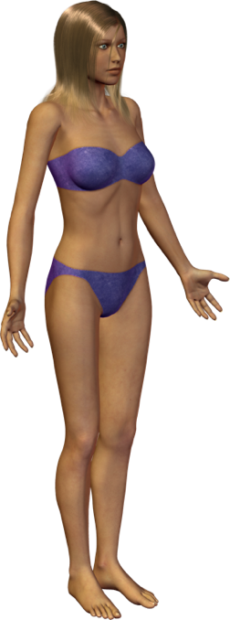
Body Planes
Frontal plane
(Mid)sagittal plane
Planes (flat surfaces) may be cut through the body or organs.
These planes are named according to the relative direction of the cut surface to the original orientation of the organ or structure in the body.
Transverse plane
Oblique plane

Slide 8
Body Planes
Frontal plane
(Mid)sagittal plane
Planes (flat surfaces) may be cut through the body or organs.
These planes are named according to the relative direction of the cut surface to the original orientation of the organ or structure in the body.
Transverse plane
Oblique plane

Slide 9

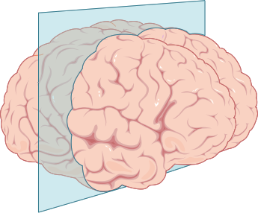
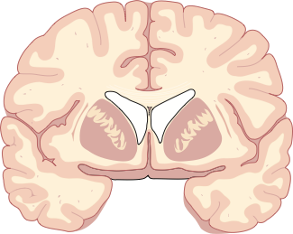
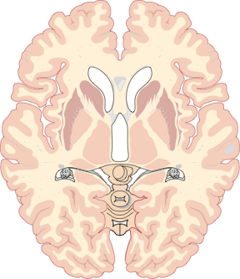
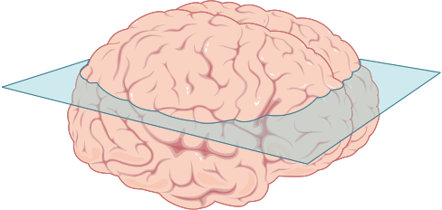
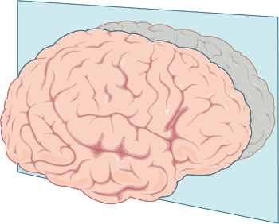
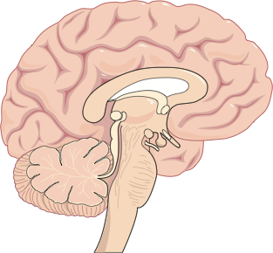
Planes and Sections
Planes divide the body, organs, or structures into sections.
Frontal plane
Frontal section
Transverse section
Transverse plane
Midsagittal plane
Midsagittal section

Slide 10
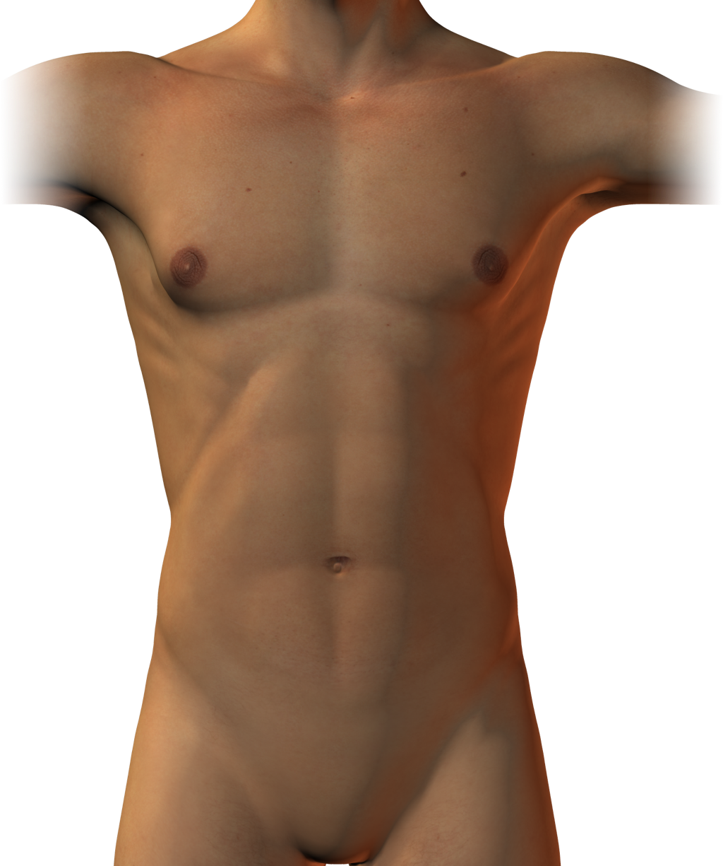
Homeostasis
CO2
Food
O2
A stylized model of a human (right) illustrates exchanges with the environment.
Fluctuating environments create a challenge to maintain cellular environments in optimum conditions.
Homeostasis is the physiological constancy of the body despite external fluctuations.
It is an essential feature of complex animals and it is maintained by the organ systems.
Heart
Cells
Metabolic
wastes (urine)
Unabsorbed matter

Slide 11
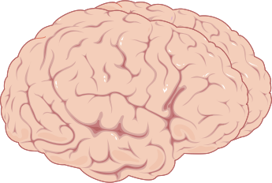

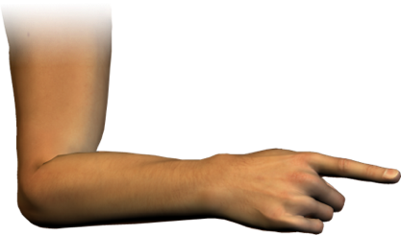
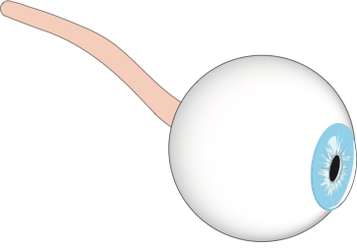
Control Systems
Homeostatic control systems have three functional components:
  A receptor to detect change
  A control center
  An effector to produce
  an appropriate response
Brain (control center)
Muscle cells (effector) in the hand
Rod or cone cells (receptor) in the eye (sense organ)

Slide 12

Feedback Systems
A stimulus disrupts homeostasis in a:
Controlled condition
monitored by:
A feedback system involves a stimulus from one part of the body invoking a response from another part which acts to alter the original stimulus.
Body systems are regulated by feedback systems.
  They may be positive or negative.
Receptors
that send input to a:
Control center
that receives the input and provides output to:
Effectors
that bring about a change or:
Response
that alters the controlled condition

Slide 13
Negative Feedback
A stimulus disrupts homeostasis in a:
Controlled condition
that is monitored by:
Negative feedback systems are by far the most common in the body.
  They form a looped system that restores the condition to a
  steady state.
  The stimulus from one part of the body produces a response that will stop or reduce the original stimulus.
Receptors
that send input to a:
Control center
That receives the input and provides output to:
Response brings about a return to homeostasis
Effectors
that bring about a change or:
Response
that alters the controlled condition

Slide 14
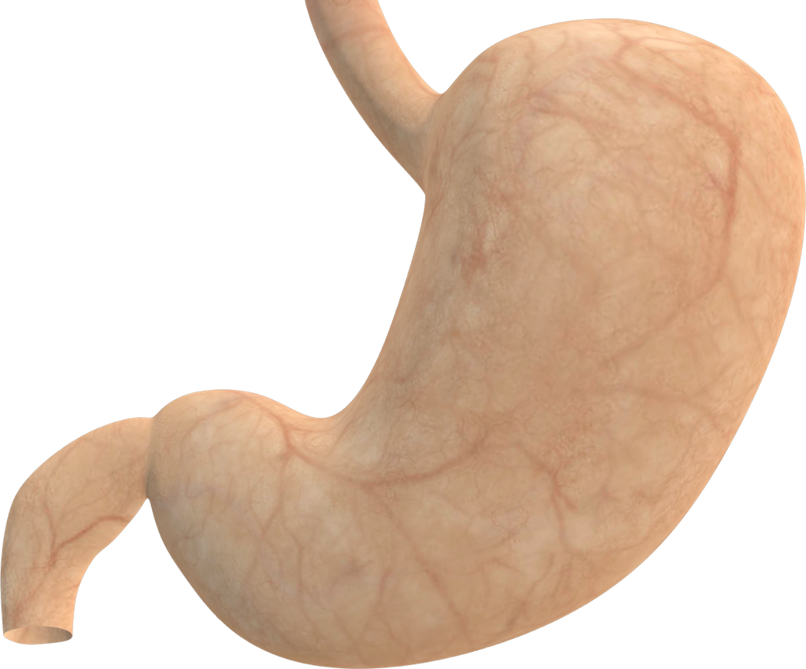







Gastric Emptying
Food entering the stomach causes stress in
Controlled condition
Stomach distention
The stretching of the stomach wall by food creates a negative feedback loop.
  The stretching triggers movement of the muscles in the stomach wall, which eventually leads to the emptying of the stomach and a return to the original state.
Receptors
Stretch receptors in stomach wall
Return to homeostasis when distention returns to steady state
Control center
Submucosal plexus
Effectors
Stomach muscles begin contractions
Response
Mixing and emptying of stomach contents

Slide 15
Positive Feedback
A stimulus disrupts homeostasis in a:
Controlled condition
that is monitored by:
Positive feedback systems are uncommon in the body.
  They form a looped system that causes a large departure from the original condition.
  The stimulus from one part of the body will cause another part to enhance the effect of stimulus.
  Such systems are unstable because they cause an escalation in the original condition.
Receptors
that send input to a:
Control center
That receives the input and provides output to:
Divergence from original steady state
Effectors
that bring about a change or:
Response
that alters the controlled condition

Slide 16
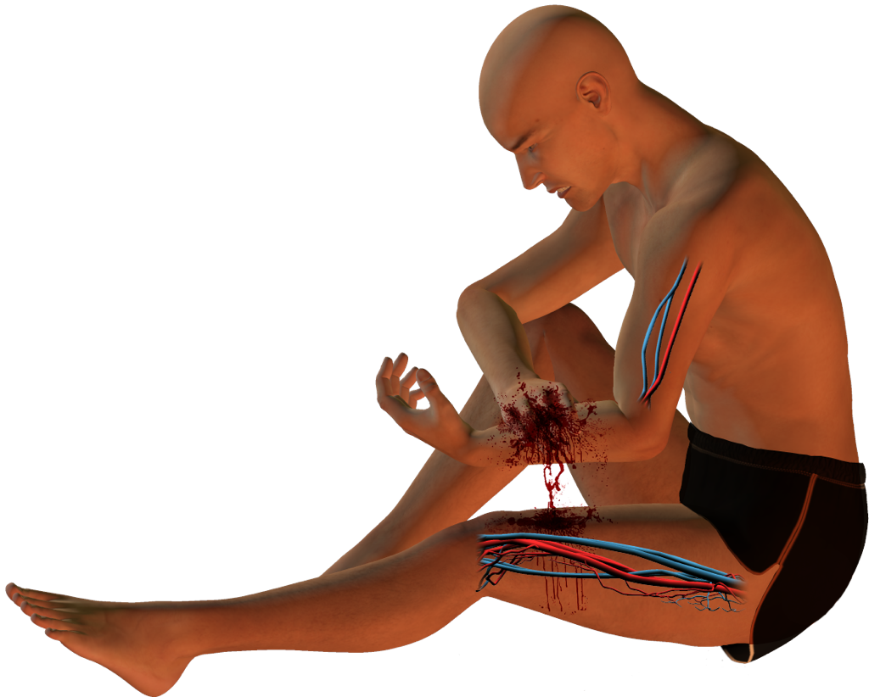
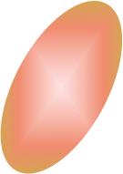
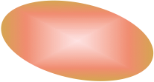
Shock and Blood Pressure
Shock. Extreme blood loss.
Controlled condition
Blood pressure falls
Positive feedback loops often have a detrimental effect on the body.
  Stage II shock results when there is a 15–30% loss of blood volume.
  It causes a positive feedback loop that results in a continuing reduction in blood pressure.
  A loss of blood pressure causes a decrease in activity in the vasomotor center, causing a decrease in vasoconstriction
  and a further decrease in blood pressure.
Receptors
Stretch receptors in artery walls
Divergence from original conditions that eventually leads to death
Control center
Vasomotor center
Effectors
Vasoconstriction decreases
Response
Blood pressure falls further

Slide 17
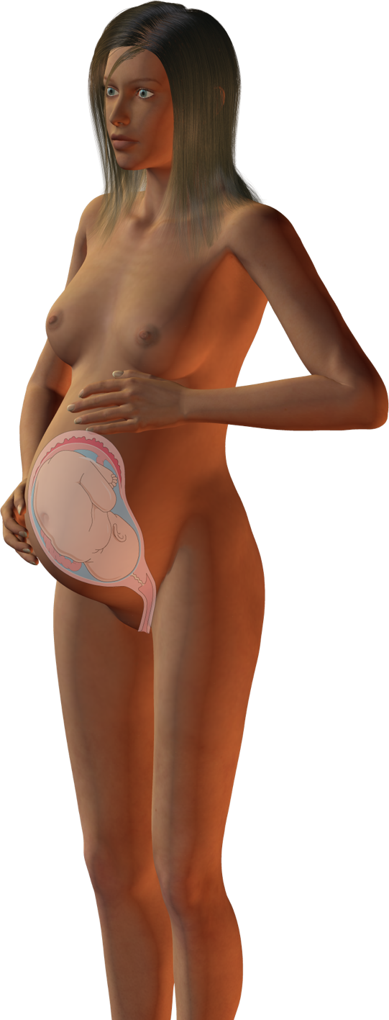






Childbirth
Labor contractions force baby’s head into birth canal
Childbirth involves positive feedback to achieve a useful outcome - birth.
  It is regulated by the hormone oxytocin.
  As contractions begin, oxytocin is released into the blood, stimulating stronger contractions and thus more oxytocin release.
  The feedback cycle ends with the delivery of the infant and the expulsion of the placenta, ending pressure on the cervix.
Controlled condition
Distention of cervix
of uterus
Receptors
Stretch receptors in cervix of uterus
Greater distention of cervix of uterus
Control center
Hypothalamus and pituitary
Effectors
Smooth muscle in wall of uterus
Cycle interruption
Birth of baby decreases distention of cervix
Response
Uterine contractions

Slide 18
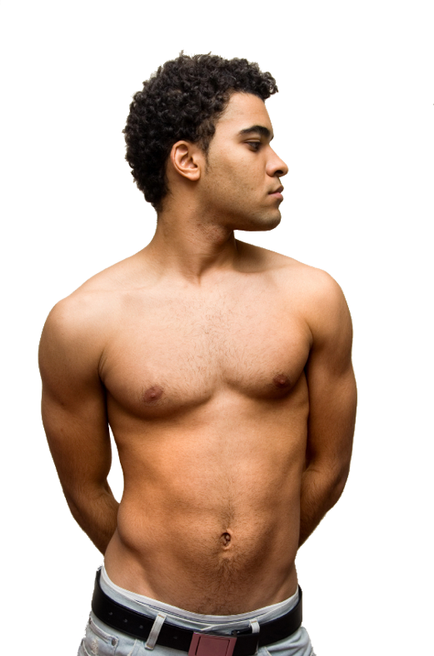
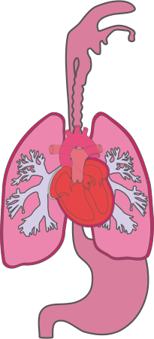
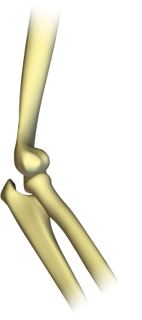

Body Membranes
A membrane is a thin layer of tissue that covers a structure or lines a cavity.
Membranes fall into two main categories:
  Epithelial membranes
    Cutaneous membrane
    Mucous membranes
    Serous membranes
  Synovial membranes
2
1
3
4

Slide 19
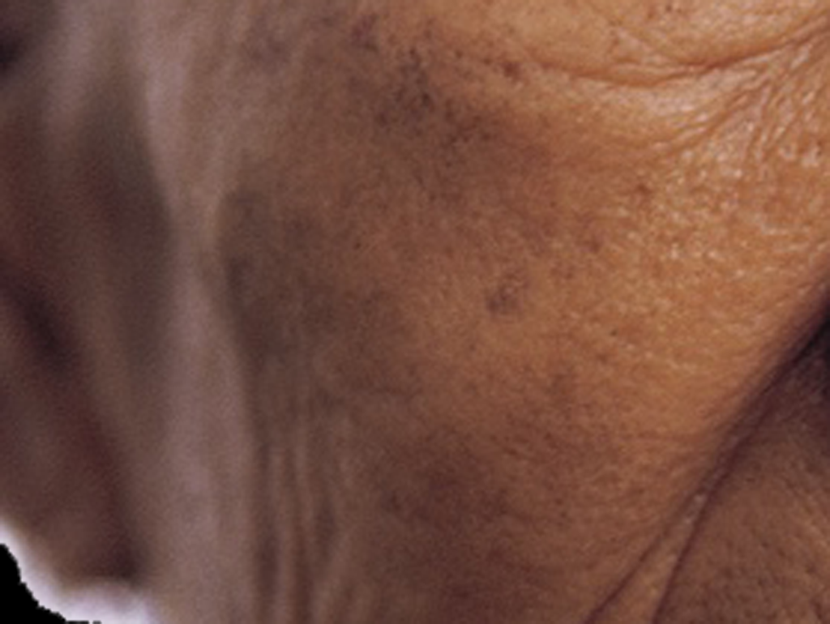
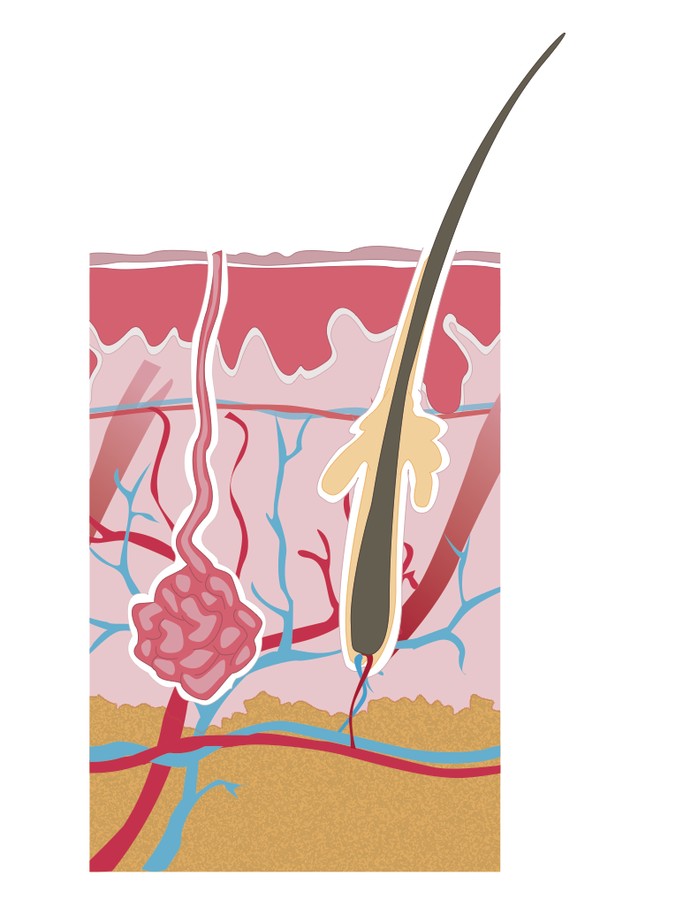
Cutaneous Membrane
Epidermis
Unlike other epithelial membranes the skin is a dry membrane.
It forms a protective covering over the surface of the body.
It is made up of an epidermis of stratified squamous epithelium and an underlying dermis of connective tissue.
Dermis:
Papillary layer
Dermis:
Reticular layer
Hypodermis

Slide 20
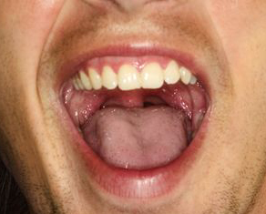
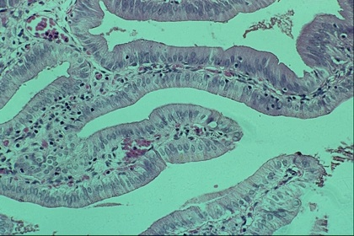
Mucous Membranes
The mucous membranes or mucosae line all body cavities that open to the exterior including:
  The respiratory tract
  The urinary tract
  The digestive tract
Mucous membranes are composed of columnar or squamous epithelial cells resting on loose connective tissue.
The epithelium of the mucosae is often absorptive or secretory.

Slide 21
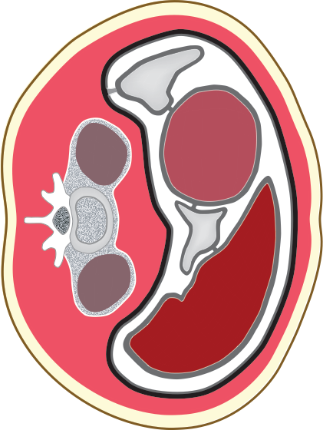
Serous Membranes
Serous membranes (serosa) line internal body cavities that are closed to the exterior.
Serosa consist of a thin layer of
squamous epithelium resting on a thin layer of loose connective tissue.
Serosa occur in pairs:
  The parietal layer lines the
  body wall.
  The visceral layer lines the
  organ within the cavity.
The membranes are separated
by a thin film of fluid called the
serous fluid.
Visceral peritoneum
Skin
Peritoneal cavity
Stomach
Spine
Kidney
Liver
Parietal peritoneum
Fat
Transverse section through abdomen

Slide 22
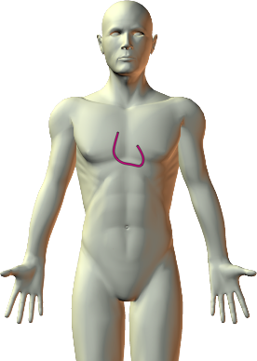
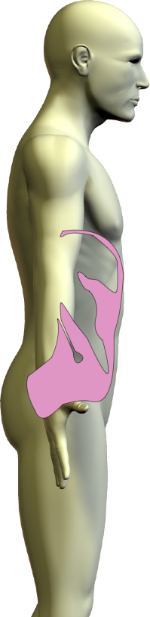
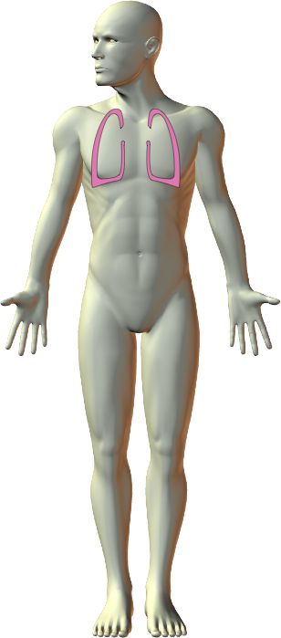
Location of Serosa
Serous membranes are named according to their location in the body:
  Peritoneum (abdomen)
  Pleura (lungs)
  Pericardium (heart)
Parietal pericardium
Visceral pericardium
Pericardial space
Pericardium
Pleura
Peritoneum

Slide 23
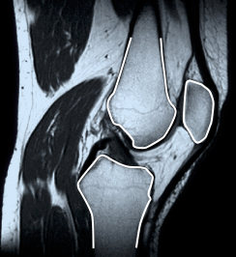
Synovial Membranes
Muscle (biceps femoris)
Synovial membranes line the capsules around joints and secrete a lubricating synovial fluid.
Composed of connective tissue.
Contain no epithelial cells.
They provide a smooth surface and cushion moving structures.
Synovial membrane
Femur
Synovial membrane
Patella
Tibia
Intrapatella fat pad
Muscle (gastrocnemius)
Sagittal section through knee

Slide 24
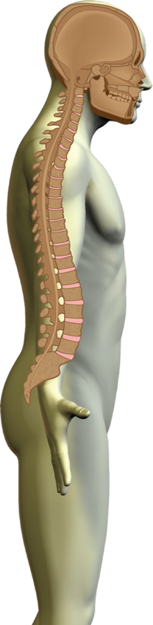
Dorsal Body Cavity
Cranial cavity
The body is divided into two main cavities.
The dorsal body cavity contains the cranial and spinal cavity.
  There is no actual division between these cavities;
  they are continuous with each other.
The cranial cavity contains the brain.
The spinal cavity, or canal, is formed by stacking together the vertebrate to form a hollow tube through which the spinal cord passes.
Spinal cavity

Slide 25
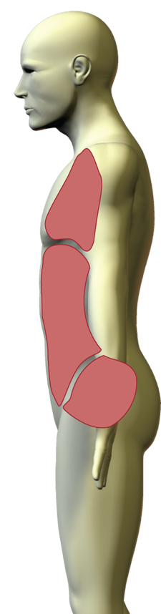
Ventral Body Cavity
The ventral body cavity contains the thoracic, abdominal, and pelvic cavities.
  The thoracic cavity is divided from the other cavities by the diaphragm.
  There is no physical division between abdominal and pelvic cavities.
The abdominal cavity contains most of the digestive organ systems.
The pelvic cavity contains the reproductive organs, the bladder, and rectum.
Thoracic cavity
Abdominal cavity
Pelvic cavity

Slide 26
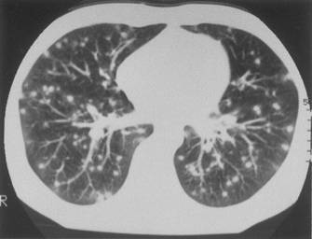
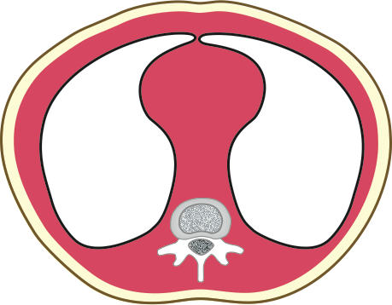
Thoracic Cavity
The thoracic cavity is divided through the middle by a mass of tissue called the mediastinum.
This division creates the pleural cavities which contain the lungs.
  The mediastinum contains the:
    heart
    thymus
    esophagus
    trachea
    blood vessels
Anterior
Mediastinum
Pleural cavity
Posterior
Anterior
Image: CDC
Mediastinum
Pleural cavity
Posterior
Spinal column
Transverse sections through the thoracic cavity

Slide 27

Maintaining Homeostasis
Homeostasis is maintained through a combination of hormonal and nervous mechanisms.
Everyday, the body must carry out tasks from regulating respiratory gases to maintaining constant body temperature.
Appropriate responses to incoming stimuli must be made and coordinated.
Maintaing Homeostasis Includes:
Coordinating responses
Regulating respiratory gases
Maintaining fluid balance
Maintaining nutrient supply
Repairing injuries
Coping with pathogens
Movie: Corey Hinde, filmed by Kerry Suter

Slide 28
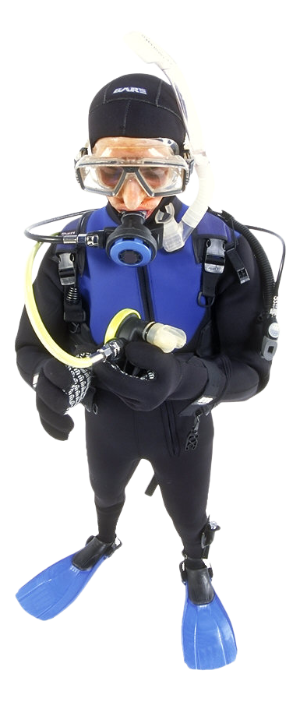
Regulating Respiration
O2 demand and CO2 production changes with activity level.
Oxygen (O2) must be delivered to all cells in the body and carbon dioxide (CO2) removed.
This is facilitated by inspiration and expiration (breathing) which brings in O2 and expels CO2.
Respiratory gases are circulated by the cardiovascular and lymphatic systems.
The rate of breathing is varied according on the body’s demand
for oxygen.
Capacity for O2 transport depends on blood hemoglobin.
Muscular activity increases oxygen demand and carbon dioxide production.

Slide 29
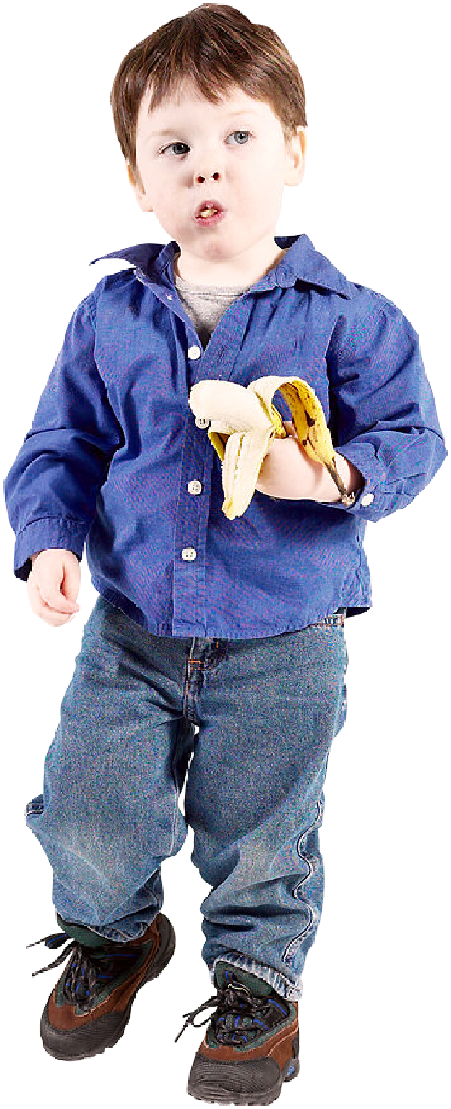
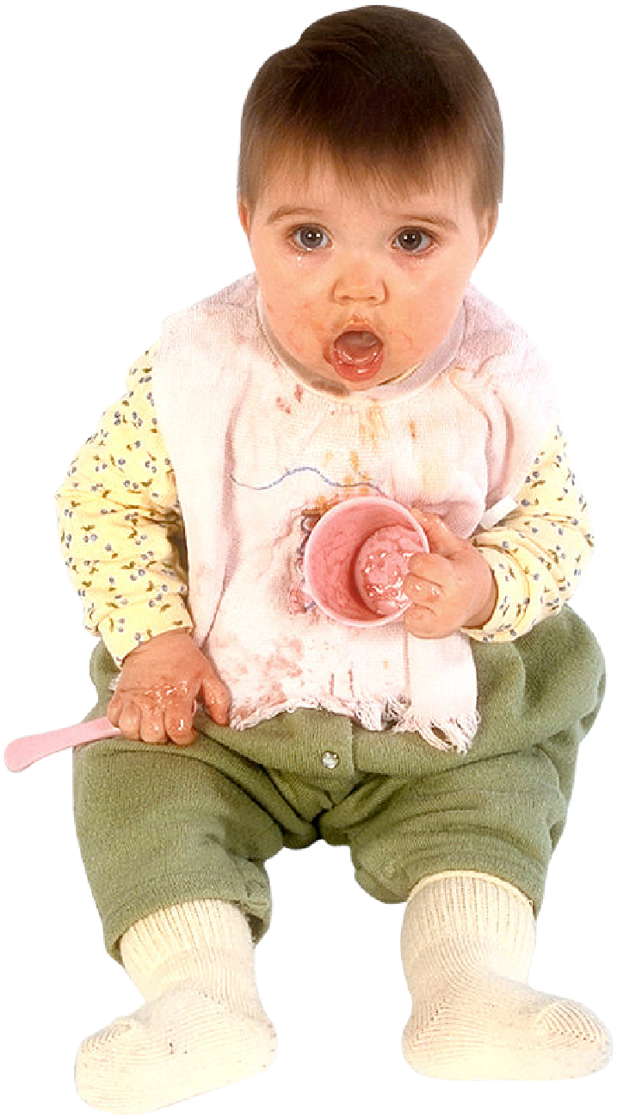
Maintaining Nutrient Supply
Food and drink provides energy and nutrients.
Food and drink must be consumed to maintain the body’s energy supplies.
The digestive system makes the nutrients in these available and the cardiovascular system distributes them through the body.
Food intake is regulated through nervous mechanisms.
Cellular uptake of glucose is largely regulated by hormones.
Digestion provides the material for the body to grow and repair tissue.
Solid waste (feces) must be eliminated.
Water must be reabsorbed from digested material.

Slide 30
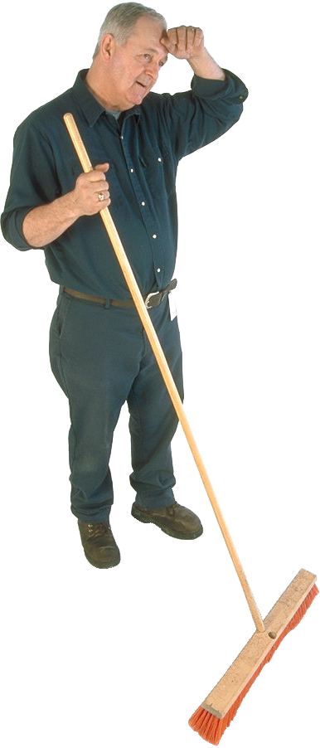
Maintaining Fluid Balance
Loss of water and ions through sweat.
Fluid and electrolyte balance in the body are maintained by the kidneys (with some help from the skin).
  The kidneys regulate the reabsorption of water and sodium from the blood in response to regulatory hormones.
Osmoreceptors monitor blood volume and bring about the release of these hormones.
Water loss through breathing.
Water and ions taken in with food and drink.
Loss of water and ions through urine and feces.

Slide 31
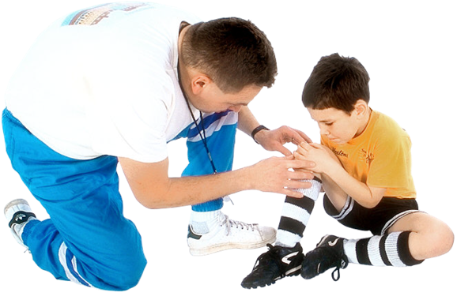
Repairing Injuries
Damage to the body’s tissues triggers the inflammatory response in the blood.
  This causes white blood cells to move to the injury site.
The response is started and ended by chemical signals released by the damaged tissue.
Wounds result in bleeding. This helps clean the wound of foreign material.
Phagocytes destroy pathogens. Platelets cause the blood to clot.
Muscle and tendon injuries occur through excess torsion or trauma.
Bone fractures are caused by heavy falls.

Slide 32
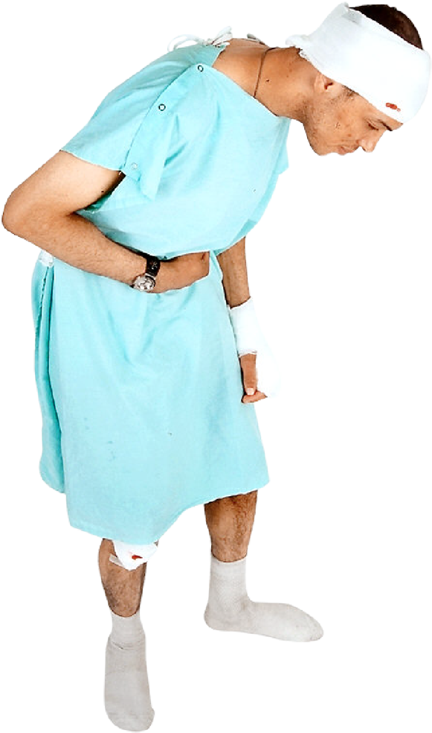





Coping With Pathogens
The body has a number of mechanisms to prevent the entry
of pathogens.
  The skin, eyes, throat, urinary and digestive tracts all have mechanisms to prevent pathogens entering the body.
  The cardiovascular and lymphatic systems circulate various white blood cells and chemicals to remove pathogens that do enter the body.
Attack by pathogens inhaled or eaten with food and drink.
Infections of the reproductive system from yeasts, viruses and bacteria.
Attack on skin and mucous membranes from fungal pathogens.

Slide 33
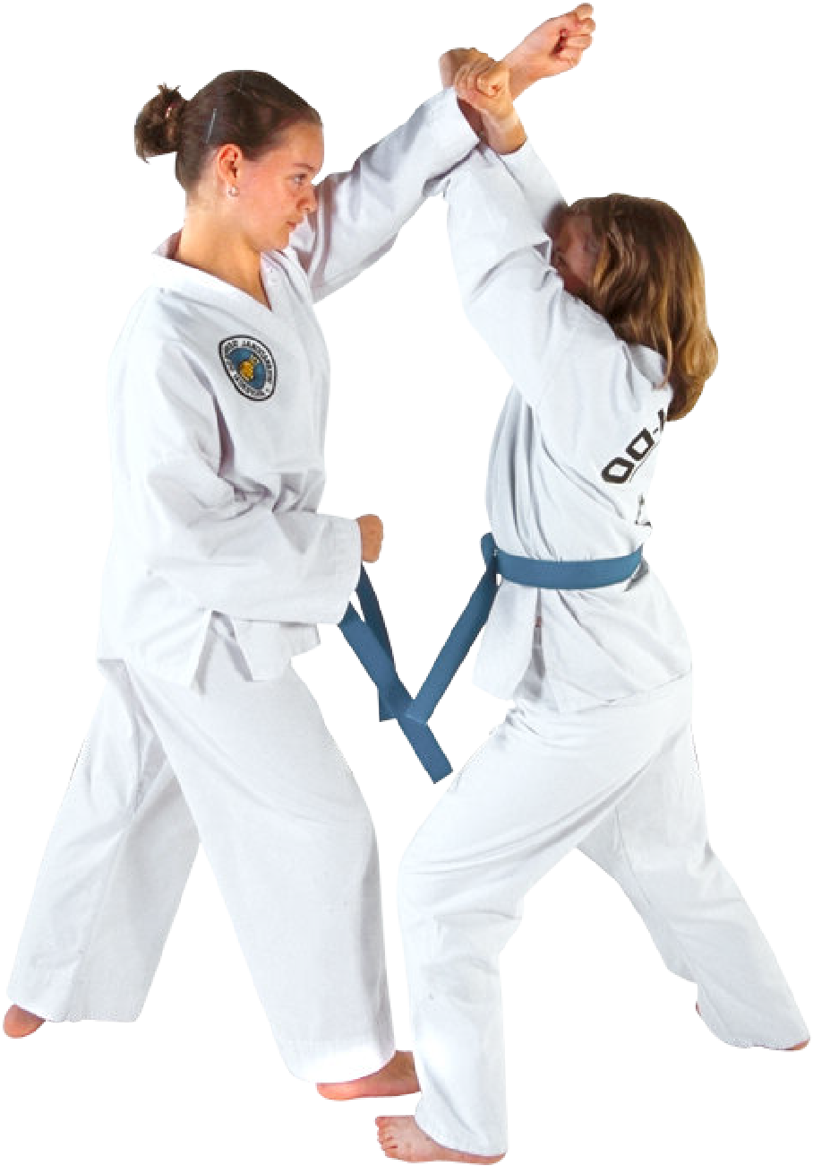
Coordination
Brain monitors and regulates hormone levels and coordinates complex movements.
The body constantly receives stimuli from the environment.
  The brain sorts these stimuli into those that require a response and those that do not.
Responses are coordinated via the nervous and/or hormonal systems.
Nervous responses to stimuli are rapid but not prolonged.
Hormonal responses are slower but last longer.
Environmental stimuli are received through the eyes, mouth, skin, nose, and ears.
Endocrine glands produce regulatory hormones.
Simple reflexes, such as pain withdrawal, allow rapid responses without involving higher brain function.

Slide 34
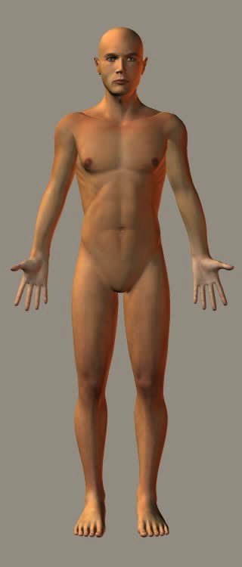
The Integumentary System
The skin is the body’s largest organ. It and its associated structures (hair, sweat glands, nails) collectively make up the integumentary system.
Unlike other epithelial membranes, the skin is a dry membrane, made up of an outer epidermis and underlying dermis.
Beneath the dermis is the hypodermis, which is largely fat. It is not part of the skin.

Slide 35
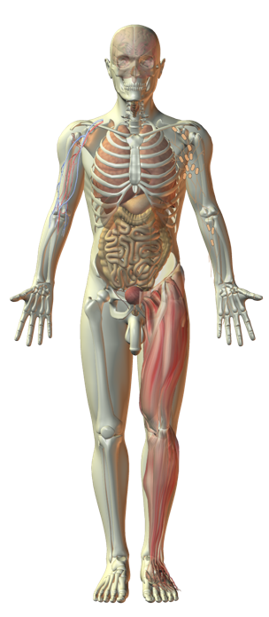
Interacting Systems
Nervous system
Endocrine system
Cardiovascular system
Respiratory system
Lymphatic system and immunity
The skin has many functions:
  Physical protection and insulation
  Water resistance
  Sensation: touch, temperature, pressure, vibration, and pain
  Temperature regulation
  Storage of water and fats
Many of its functions involve interactions with other organ systems. These are described in the following slides.
Digestive system
Urinary system
Reproductive system
Muscular system
Skeletal system

Slide 36
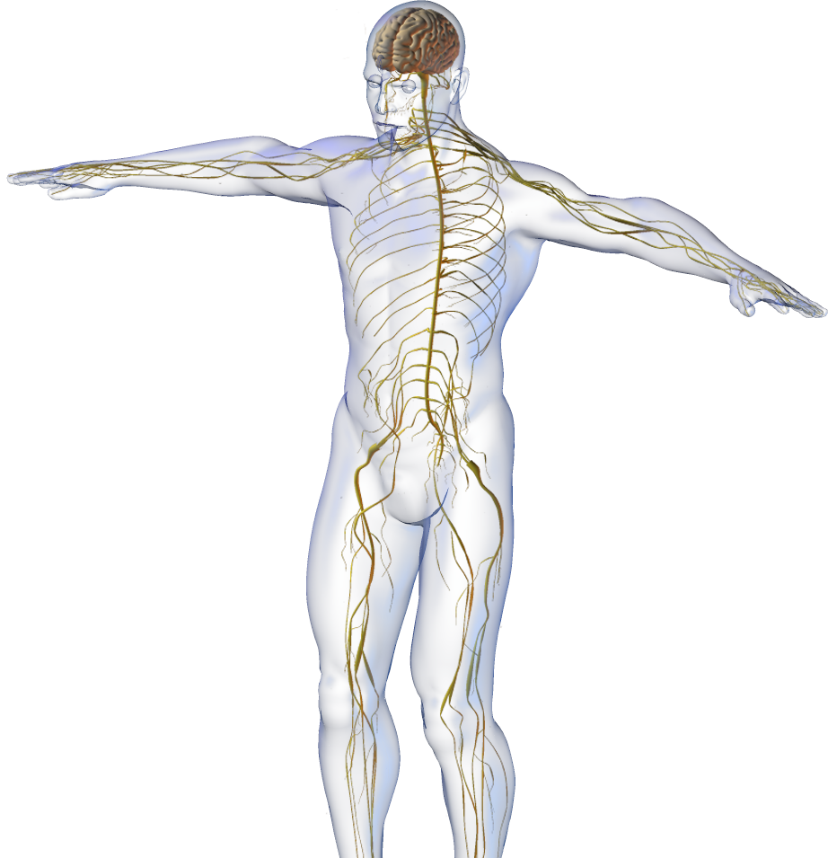




Nervous System
The integumentary system interacts with the nervous system:
  Many sensory structures (e.g. Pacinian corpuscle) and simple receptors (e.g. thermoreceptors) are located in or associated with the skin.
  CNS interprets sensory information from the skin’s sensory receptors.
  The nervous system regulates blood vessel dilation and sweat gland secretion.
  Nervous stimulation of the arrector pili muscles causes erection of hair (thermoregulatory response).
Thermoreceptors
Sweat gland
Goose bumps

Slide 37




Digestive System
The integumentary system interacts with the digestive system
  Skin synthesizes an essential vitamin D precursor. Vitamin D is required for the absorption of calcium from the gut.Digestive system provides the nutrients
  for growth, repair, and maintenance of the skin (delivered via the blood vessels of the cardiovascular system).
Nutrients to skin
Calcium absorption
Vitamin D

Slide 38


Skeletal System
The integumentary system interacts with the skeletal system
  Skin absorbs UV light and to synthesize a vitamin D precursor.
  Vitamin D is involved in calcium and phosphorus metabolism.
  Bone deposition and skeletal health relies on normal calcium absorption and deposition of calcium salts.
Vitamin D
Calcium deposition

Slide 39






Endocrine System
The integumentary system interacts with the endocrine system
  Estrogens help to maintain skin hydration.
  Changes in skin pigmentation are associated with hormonal changes during pregnancy (e.g. linea nigra) and puberty.
  Androgens activate the sebaceous glands and help to regulate the growth of hair.
Estrogen
Linea nigra
Sebaceous gland

Slide 40




Cardiovascular System
The integumentary system interacts with the cardiovascular system
  Blood vessels transport O2 and nutrients to the skin and remove CO2 and other wastes (via the blood).
  The skin prevents fluid loss and
  acts as a reservoir for blood.
  Dilation and constriction of blood
  vessels is an important
  thermoregulatory mechanism.
  The blood supplies substances (e.g. triglycerides, fatty acids, and amino acids, required for functioning of the sebaceous and sweat glands.

Slide 41




Urinary System
The integumentary system interacts with the urinary system
  Skin (with the skeleton) helps to protect kidneys and associated structures of the urinary system.
  Salts and some nitrogenous wastes are excreted in sweat.
  The conversion of vitamin D to its active form occurs in the kidneys.
Photo: Bibikoff
Vitamin D

Slide 42



Respiratory System
The integumentary system interacts with the respiratory system
  The respiratory system provides oxygen to the cells of the skin via gas exchange with the blood.
  Removes carbon dioxide (gaseous metabolic waste) from the cells of the skin via gas exchange with the blood.
O2
CO2

Slide 43


Reproductive System
The integumentary system interacts with the reproductive system
  Mammary glands, which are modified sweat glands, nourish the infant in lactating women.
  Skin stretches during pregnancy.
  Changes in skin pigmentation are associated with pregnancy and puberty.
Breast feeding
Linea nigra (dark pigment)

Slide 44


Lymphatic System
The integumentary system interacts with the lymphatic and immune systems
  Tissue fluid bathes and nourishes the skin cells.
  Skin and its secretions provides a physical and chemical barrier against the entry of pathogens.
  Lymphatic vessels prevent edema, including cutaneous edema, by collecting and returning tissue fluid to the general circulation.
Photo: James Heilman CC 3.0
Hives (localized edema caused by an allergy)

Slide 45

Muscular System
The integumentary system interacts with the muscular system
  Muscular activity generates heat, which is dissipated via an increase in blood flow to the skin’s surface.
  Muscular activity and increased blood flow increases secretions from the skin’s glands (e.g. sweating).
Heat dissipated
Sweat gland

Slide 46


Structure of the Skin
Moderately keratinized layer
The skin is made up of two kinds of tissue, the epidermis and the dermis, resting on an underlying layer of fat.
The epidermis consists of stratified squamous epithelium with up to five layers of cells.
  The basal layer is the site of skin cell generation.
  The basal layer contains melanocytes, which contain the pigment melanin.
  Cells flatten and become keratinized as they migrate from the basal layer to the surface.
The dermis contains connective tissue with:
  Collagen (strength)
  Elastic fibers (flexibility)
  Reticular fibers (support)
Skin epidermis from the palm of the hand
Very thick keratinized layer
Skin epidermis from the heel of the foot

Slide 47

Structure of the Skin
Epidermis
(outer skin layer)
Dermal papillae
(extension of dermis into epidermis)
Epidermis
Dermis:
Papillary layer
Sebaceous gland
produces oily secretions
Arrector pili muscle raises and lowers the hair
Dermis:
Reticular layer
Sweat gland
produces watery secretions
Hair root
(area of hair growth)
Hypodermis not part of skin
Blood vessels
bring oxygen and nutrients and remove wastes
Pacinian corpuscle
(mechanoreceptor)
Fat in hypodermis

Slide 48

Structure of the Skin
Dermal papillae
Epidermis
Arrector pili muscle
Sebaceous gland
Sweat gland
Hair root
Blood vessels
Hypodermis
Skin section

Slide 49

Functions of the Skin
The many functions of the skin include:
  Thermoregulation - cooling by sweating, heating by flattening the hair.
  Protection against pathogens - the
  skin is a physical barriers and secretes oils with antimicrobial activity.
  Sensory reception - the skin senses touch, heat, vibration, pressure, and pain.
  Protection from UV radiation - melanin in the skin helps protect against excess absorption of ultraviolet (UV) light.
  Storage of water and fats.
  Water resistance - nutrients are retained by the body and not washed away.
  Vitamin manufacture - The skin absorbs UVB light to synthesize an essential precursor to vitamin D.

Slide 50


Thermoregulation
Body temperature is regulated by the hypothalamus. In humans, the hypothalamus has a “set point” of 36.7ºC.
The hypothalamus responds to core temperature changes and nerve impulses from receptors in the skin.
It coordinates appropriate nervous and hormonal responses to return the body to its normal temperature.

Slide 51

The Skin and Thermoregulation
Hairs raised or lowered to increase or decrease the thickness of the insulating air layer.
Thermoreceptors in the dermis detect changes in skin temperature outside the normal range and send nerve impulses to the hypothalamus.
Thermoreceptors come in two types:
  Hot thermoreceptors
  detect a rise above 37.5ºC
  Cold thermoreceptors
  detect a drop below 35.8ºC.
The regulation of temperature by the skin forms a negative feedback loop.
Sweat glands produce sweat in response to parasympathetic stimulation from the hypothalamus. Sweat cools through evaporation.
Fat in the subdermal layers insulates the organs against heat loss.
Blood vessels in the dermis
- dilate to promote heat loss
- constrict to reduce heat loss

Slide 52

Counteracting Heat Loss
Heat promoting center in the hypothalamus monitors fall in temperature below 35.8ºC and promotes responses that conserve heat.
Factors affecting heat loss:
  Any factor that increases the thermal gradient will accelerate heat loss through radiation:
    Wind (wind chill factor)
    Cold external temperatures
    Being inadequately clothed
  Being wet or in cold water accelerates conductive heat loss.
  Dehydration and circulatory shock accelerate heat loss because a lower blood volume reduces capacity to retain heat.
Responses to heat loss are brought about primarily through the sympathetic nerves of the autonomic nervous system.
Thyroxine and epinephrine increase metabolic rate.
In extreme cold thyroxine and epinephrine increase energy-releasing activities in the liver.
Muscle activity produces internal heat.
Erector muscles of hairs contract to raise hairs and increase the insulating layer of air. Blood flow to skin decreases.

Slide 53

Counteracting Heat Gain
Heat losing center in the hypothalamus monitors any rise in temperature above 37.5ºC and coordinates responses that increase heat loss.
Factors causing heat gain include:
  Gain of heat through a warmer environment.
  High humidity reduces effectiveness of evaporative cooling.
  Excessive fat deposits make it harder to lose heat generated by activity.
  Heavy clothing that traps air and doesn’t allow heat to escape.
Responses to heat gain are brought about primarily through
the parasympathetic nerves of the autonomic nervous system.
Sweating increases cooling by evaporation.
Muscle tone and metabolic rate are decreased, reducing heat output.
Blood flow to skin increases.
Erector muscles of the hairs relax, flattening hair and reducing the insulating air layer.

Slide 54

Hypothermia
Hypothermia is a condition caused when the body’s core temperature drops below 35ºC.
The condition ranges from mild to severe depending how low the body temperature has dropped.
Severe hypothermia results in mental confusion, including inability to speak and amnesia, organ failure, and death.

Slide 55

Hypothermia and Exposure
Two factors are important in determining the length of time until the onset of hypothermia when immersed in water:
  Water temperature. The lower the temperature of the water, the more rapid the onset of hypothermia.
  Body shape: Shorter, stockier people lose body heat more slowly than taller, thinner people.
Hypothermia resulting in death highly likely in this region
Body shape: short and stocky
Body shape: tall and thin
Hypothermia resulting in death highly unlikely in this region

Slide 56

Departures from Normal
Hyperthermia: Body temperatures above normal cause metabolic problems that can lead to death.
Mild hypothermia: Shivering. Vasoconstriction reduces blood flow to the extremities. Hypertension and cold diuresis (increased urine production due to the cold).
Moderate hypothermia: Muscle coordination becomes difficult. Movements slow or labored. Blood vessels in ears, nose, fingers, and toes constrict further resulting in these turning a blue color. Mental confusion sets in. In some cases, victim may shed clothing (paradoxical undressing).
Severe hypothermia: Speech fails. Mental processes become irrational, victim may enter a stupor. In some cases, the brain stem produces hide and die behavior. Organs eventually fail and death follows.
Normal body temperature

Slide 57


Treating Hypothermia
Treating hypothermia:
Mild hypothermia can be treated by passive rewarming, using body heat coupled with warm, dry, insulated clothing in a warm dry environment.
Moderate hypothermia requires active external rewarming. This involves using warming devices such as hot water bottles or warm water baths.
Severe hypothermics must be treated with active internal or core warming. Methods include delivery of warm intravenous fluids, inhaling warm moist air, or warming the blood externally by using a heart-lung machine.

Slide 58


Hyperthermia
Hyperthermia is the elevation of the body’s core temperature beyond normal (occurring around 38ºC).
  Hyperthermia is caused by the body absorbing or generating heat faster than it can be dissipated. It is physiologically different from fever.
  Severe hyperthermia can cause the body’s enzymes and organ systems to fail.
  Hyperthermia can be induced by some drugs, and is sometimes used in treating cancer.
Over exertion or exposure to high temperatures while taking in too little water can rapidly lead to hyperthermia

Slide 59
Hyperthermia and Fever
Core temperature reset. Normal body temperature now hypothermic. Heat must be gained.
During fever the hypothalamus resets the required body temperature to higher than normal.
  The body then tries to reach this new temperature.
During a period of hyperthermia, the temperature set by the hypothalamus remains the same so that the body tries to lose excess heat.
39
Body temperature too high. Heat must be lost.
38
Body temperature too low. Heat must be gained.
37
Normal Body Temperature
Body Temperature
36
35
Hyperthermia
Hypothermia
Fever

Slide 60


Diagnostic Imaging
Diagnostic medicine is a continually improving field.
Medical specialists can now use sophisticated imaging techniques to see into the body before any surgery is performed.
This allows for better planning for surgery and treatment of medical conditions.
X-rays
CT scanning

Slide 61

Medical Imaging:
X-Rays
Since their discovery in 1895,
X-rays have become important in diagnosing of internal injuries:
  X-rays are an energetic form of electromagnetic radiation.
  They are able to pass through soft tissues but are absorbed by more dense ones.

Slide 62


X-rays
X-rays passing through a patient on to a film can be used to identify fractures or abnormalities in bone as well as some denser tissue.
Despite advances in other medical imaging technologies, X-rays remain a relatively cheap and reliable method of diagnosis.

Slide 63




X-rays
X-rays are produced by focusing electron beams from a cathode onto an anode.
  The X-rays created are focused onto the patient. The X-rays travel through the patient’s soft tissues but are absorbed by the denser bone.
  Film placed behind the patient reacts with the X-rays and turns black where exposed to
  X-rays, while remaining white where no X-rays have been absorbed.
Intensifying screen
Cathode
First layer allows only aligned X-rays to pass onto film for a clearer image.
Visible light photons cause a chemical reaction on the film turning exposed parts black.
Anode
X-ray generator
Object
Second layer converts X-rays into visible light to intensify the image.
Film-screen cassette

Slide 64


Radionuclide Scanning
Radionuclide scanning allows specialists to see how specific molecules are taken up by the body and so deduce how certain processes work.
Radiation emitted by weak radioactive substances placed into the body is captured by a gamma camera.

Slide 65


Ultrasound
Ultrasound scanning uses a device to send sound waves into the body and receive their echoes.
Ultrasound scanners operate at between 2 and 18 megahertz.
  Higher frequencies provide greater resolution but do not penetrate far into the body.
  Lower frequencies produce lower resolution images but penetrate deeper into the body.
Head
Jaw
Ear

Slide 66



Ultrasound
Ultrasound is commonly used for imaging fetuses during pregnancy but can also be used to image most soft tissues and organs such as the kidneys and bladder.
Ultrasound can produce 2D, 3D, or 4D images depending on the computer software being used.
Nose
Head
Image: Sam Pullara CC. 2.0
Hand
Staecker
Kickstart70
2D standard image (baby sucking thumb) generated by bouncing high frequency sound waves off the fetus
3D images are produced by rapidly sending sounds waves at various angles. A computer uses the echoes to construct a 3D image
4D images are created by rapidly processing 3D images into animated scenes

Slide 67

Ultrasound during Pregnancy
During pregnancy ultrasound is used to view the uterus and fetus during pregnancy.
  Scans are often performed at 12 weeks and 20 weeks into a pregnancy.
  Ultrasound maybe performed earlier if there are signs or indications that the fetus is not developing normally.
  Ultrasound is also used to diagnose:
    Multiple pregnancies
    (twins, triplets).
    Gross fetal abnormalities
    such as trisomy, (e.g. Down
    syndrome) and neural tube
    defects.

Slide 68

Uses of Pregnancy Ultrasound
Ultrasound is also used to determine fetal:
  Age and growth
  Gender
  Conception date
  Placental position
This information aids pregnancy management.
Ultrasound is apparently safe, but the risks associated with frequent scans are unknown.

Slide 69

Ultrasound of the Uterus
The positioning of the placenta (P) and umbilical cord (U) is checked. The placenta should not lie over the cervix (C), as this causes problems with delivery.
Ultrasound probe directs sound waves at the abdomen of the mother
High frequency, inaudible sound waves are reflected off the fetus and back to a receiver in the probe.
The operator takes specific measurements (on screen) of certain regions of the body, e.g. limb length, and head length and circumference. These are used to determine if development is normal and growth is within the expected range.

Slide 70


MRI
Magnetic Resonance Imaging uses a magnetic field to align the nuclear magnetism of hydrogen atoms of water in the body.
Radio frequency fields are used to realign the atoms. Scanners receive the signals they give off when returning to their original state.
Computer software interprets these signals to produce extremely sharp images.

Slide 71

Interpreting MRI Scans
MRI is used to distinguish pathological tissue (e.g. a brain tumor) from normal tissue.
One of the advantages
of an MRI scan is that it
is apparently harmless
to the patient, even when
they receive multiple
scans because it uses
strong magnetic fields
and non-ionizing radiation.

Slide 72


CT
Scanning
Computed Tomography uses X-rays to produce images.
CT scanning uses multiple X-ray beams instead of just one as in conventional X-rays.
These multiple beams are passed through the body and computer software is used to reconstruct the pictures from each X-ray slice into a
3-dimensional image.

Slide 73


Endoscopy
An endoscope is a flexible tube comprising fibre-optic cables with lenses attached. It is used to image the body’s interior.
The endoscope can be inserted into any body opening or placed through a small incision.
The end of the device may be able to pan left and right, or up and down, and can be used to remove tissue for biopsy.
Photo: Benutzer Kalumet Creative Commons Share Alike 3.0

Slide 74

Biosensors
Biosensors are electronic monitoring devices that use biological material to detect the presence or concentration of a particular substance.
Enzymes are ideally suited to this purpose because of their specificity and sensitivity.
An example is the use of the enzyme glucose oxidase to detect blood sugar levels in diabetics.
Glucose oxidase is immobilized in a semi-conducting silicon chip. It catalyses the conversion of glucose to gluconic acid.
H⁺ from the gluconic acid cause electrons to move. This is detected by the transducer. The strength is proportional to the the blood glucose concentration.
Membrane permeable to glucose
Results are shown on a liquid crystal display.
Biological recognition layer
Transducer
Amplifier
Plastic sleeve
The signal is amplified.

Slide 75
Glossary
Click a word from the glossary to go to that slide!
Anode | An electrode through which electricity flows into a polarized electrical device. The anode is positive in devices that consume power and negative in devices that produce power.
Autonomic Nervous System | A portion of the peripheral nervous system. It controls visceral functions, for example heart rate, digestion and respiration rate.
Biopsy | The removal of tissue or material from an organism for examination.
Cathode | An electrode through which electricity flows out of a polarized electrical device. The cathode is negative in devices that consume power and positive in devices that produce power.
Dermis | A layer of connective tissue between the epidermis and subcutaneous tissue. It is made of two layers (the papillary and reticular dermis).
Electrolyte | Substance containing ions that can dissociate in water to conduct electricity.
Electromagnetic radiation | Radiation in the form of self propagating waves of energy containing electrical and magnetic fields oscillating perpendicular to each other.
Enzyme | A globular protein which acts as a catalyst to speed up a specific biological reaction.
Epithelium | A sheet of cells tightly bound together lining cavities and surfaces of structures in multicellular organisms.
Gross | Large enough to be visible to the naked eye, e.g. gross anatomy.
Hormone | A chemical messenger that induces a specific physiological response in a target tissue.
Hypothalamus | The region of the brain which coordinates the nervous and endocrine systems via the pituitary gland.

Slide 76
Glossary
Click a word from the glossary to go to that slide!
Pathogen | A disease-causing organism
Parasympathetic nerves: | A branch of the autonomic nervous system that generally has an inhibitory effect.
Physiological | Relating to physiology: the study of the functions of a living organism and its parts.
Stimuli (singular: stimulus) | Physical or chemical changes in the environment which are capable of causing a response in an organism.
Sympathetic nerves | A branch of the autonomic nervous system that has generally excitatory effects.
Vasoconstriction | Narrowing of the blood vessels (particularly the large arteries, small arterioles and veins) as a result of contraction of their muscular walls.

Slide 77


Slide 78
Conditions of Use
NOTE: Presentation Media = presentations available on CD-ROM/DVD-ROM or as downloads
BIOZONE retains copyright to the intellectual property included in the Presentation Media files, with acknowledgement that certain photos are used under license and are credited appropriately.
You MAY:
Use the Presentation Media files for presentations in your classrooms using a
data projector, interactive whiteboard or overhead projector.
Place the Presentation Media files on any staff computer within the school,
including staff laptops, but not in contradiction to clause (g).
Place the Presentation Media files on:
  The school’s intranet (school computer network)
  VLE (Virtual Learning Environment)
  A CMS (Content Management System).
Student and staff access must be restricted to those who are enrolled/working on the campus of the registered purchaser. Student and staff access to a VLE or a CMS must be controlled by a user login and password protocol, but not in contradiction to clause (f). If students have access, they need to be made aware of the Conditions of Use and are only allowed to view the content.
Edit and customize the Presentation Media files by adding, deleting, and
modifying information to better suit your needs, but not in contradiction to
clauses (h) - (l).
Print out the Presentation Media files in PowerPoint® or Keynote®
“Handouts” mode for the express purpose of allowing students to make their
own notes about the presentation, but not in contradiction to clause (j).
You MAY NOT:
Place the Presentation Media files on to the Internet or on a service that may be
accessed off-campus unless access to the service is protected by a user login
and password protocol, and is restricted to students and staff enrolled/working on
the campus of the registered purchaser.
Place the Presentation Media files on student laptop computers.
REMOVE any of the references to BIOZONE, the title slides, copyright
notices, photo credits, or Conditions of Use from the Presentation Media
files.
Create a NEW document using any of the graphics/images in the Presentation
Media files.
Print the Presentation Media files on to paper to make your own worksheets for
distribution to students.
Incorporate any part of the Presentation Media files for the production of another
commercial product.
Share or give away any content off-campus. This prohibition apples to, but is not
limited to, sharing via the Internet or any website, (examples: YouTube, slide
sharing websites).
Conditions of Use are subject to change without notice. Visit www.thebiozone.com/conditionsofuse

Slide 79
Photo Credits
Photographic images are used under license from the following commercial photo libraries:
  Corel Corporation Professional Photos (uncoded)
  ArtToday.com (coded AT)
  Clipart.com (coded CA)
  PhotoObjects.com (coded PO)
  iStock.com (coded iStock)
  Hemera Technologies Inc. (coded Hemera)
  Photos.com (coded PC)
  Education interactive (coded EII)
  Visuals unlimited (coded UV)
  Waikato Microscope Unit (Coded WMU)
  Digital Stock (coded DS)
  LifeArt (coded LA)
3D models were created using Poser 8
Additional artwork and photographs are the property of BIOZONE International Ltd. All rights reserved.
Some 2D artwork has been adapted from TechPool STUDIOS LifeArt Collections, used under licence.
Images from the Public Domain: Where these licenses have been used, authors and licenses have been acknowledged alongside their image.
  Centers for Disease Control (coded CDC)
  National Institutes of Health (coded NIH)
  Images from the public domain include limited copyright,
  copyright expired, uncopyrighted, or uncopyrightable material:
    Licenses including: GNU Free Documentation License
    http://www.gnu.org/copyleft/fdl.html
    Creative Commons Attribution Share Alike
    http://creativecommons.org/licenses/by-sa/3.0/
    Wikimedia Commons
NOTE: Where images are edited or moved from or within this file, the accompanying photo credit must be retained.

Slide 80


